Slide 1
E-Commerce Dashboard Analysis
In-depth analysis and insights from Power BI dashboard

Slide 2
Overview of Dashboard Objectives
Sales and Marketing Report
Purpose: To analyze sales performance, customer behavior, and marketing campaign effectiveness.
Questions:
What are the top-selling products and regions?
How is customer acquisition and retention trending?
Which marketing channels are driving the most conversions?
What is the customer lifetime value?

Slide 3
Data Information
• The dataset provided for this project is of Shopee, Brazil. To adhere to privacy policies, certain columns have been deleted from the dataset.
• The data provided to you contains all the required detail such as
orders, customer demographics, products and the segment
information, quantity, shipping cost etc.
• All the information about the features is present in
Data_Dictionary.pdf

Slide 4
Overview of the Dashboard
Sales by Country: A bar chart showing sales across different countries.
Age Distribution: A pie chart showing the distribution of customers by age.
Sales Amount by Product: A bar chart showing the sales amount for different product categories.
Total Orders by Month: A line chart showing the trend of orders over time.
Total Revenue and Total Orders: Key performance indicators (KPIs) displayed as numerical values.

Slide 5
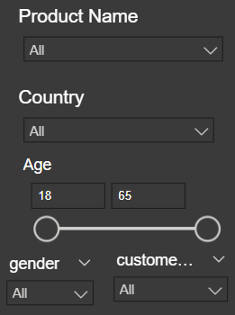
The E-commerce Dashboard provides several filter options to allow users to customize the displayed data:
1. Product Name Filter:
Dropdown Menu: Users can select specific product names from the dropdown menu to view detailed sales information for that particular product.
All Option: Selecting "All" displays data for all products.
2. Country Filter:
Dropdown Menu: Users can select specific countries from the dropdown menu to view sales data for that country.
All Option: Selecting "All" displays data for all countries.
3. Age Filter:
Slider: Users can adjust the slider to select a specific age range.
This allows for analysis of sales trends based on different age demographics.
4. Gender Filter:
Dropdown Menu: Users can select specific genders (Male or Female) or choose "All" to view data for all genders.
By utilizing these filters, users can gain deeper insights into specific segments of the data, such as:
Sales Performance by Country: Analyze the sales performance of different countries.
Product Popularity by Age Group: Identify products that are popular with specific age groups.
Gender-Based Shopping Trends: Understand the purchasing behavior of different genders.
Product-Specific Analysis: Dive deep into the sales and performance of individual products.
These filters empower users to explore the data from various angles and uncover valuable insights to inform business decisions.

Slide 6
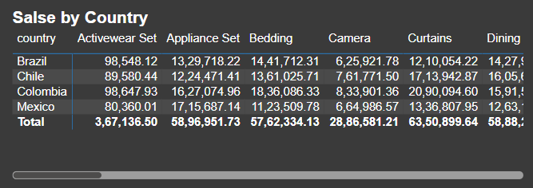
Sales by Country
Sales by Country
This bar chart provides a visual representation of the sales generated from different countries. It highlights the top-performing countries and their relative contributions to the overall sales.
Key Insights:
Top-Performing Countries: Brazil and Mexico stand out as the top-performing countries, generating the highest sales.
Market Potential: Other countries like Chile and Colombia also show significant potential for growth.
Regional Analysis: The chart can be used to identify regional trends and opportunities.

Slide 7
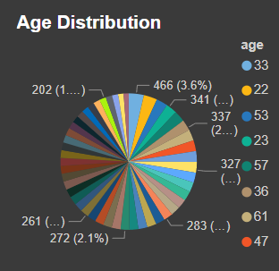
Age Distribution
This pie chart shows the distribution of customers based on their age groups. It helps understand the target audience and their preferences.
Key Insights:
Dominant Age Groups: The chart reveals the age groups that constitute the majority of the customer base.
Marketing Targeting: This information can be used to tailor marketing campaigns and product offerings to specific age groups.

Slide 8
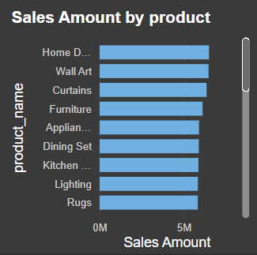
Sales Amount by Product
This bar chart displays the sales amount for different product categories. It helps identify the best-selling products and their revenue contribution.
Key Insights:
Top-Selling Products: Activewear sets, appliances, and bedding emerge as the top-selling product categories.
Product Performance: The chart can be used to assess the performance of individual products and identify opportunities for improvement.

Slide 9
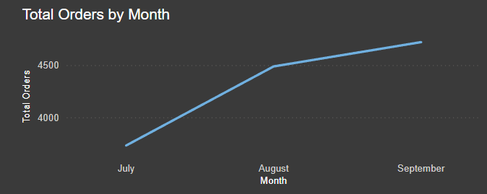
Total Orders by Month
This line chart shows the trend of total orders over time. It helps identify seasonal patterns and overall growth trends.
Key Insights:
Seasonal Trends: The chart reveals potential seasonal fluctuations in sales, with certain months experiencing higher demand.
Growth Trend: The overall upward trend in the line chart indicates a growing customer base and increasing sales.

Slide 10
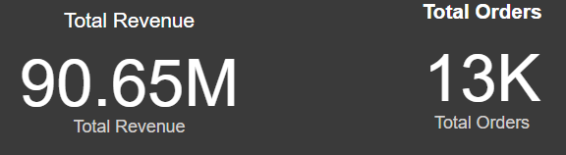
Total Revenue and Total Orders
These key performance indicators (KPIs) provide a snapshot of the overall business performance. They show the total revenue generated and the total number of orders placed.
Key Insights:
Overall Performance: The high total revenue and order volume indicate strong business performance.
Growth Potential: The dashboard can be used to set targets and track progress towards achieving business goals.
Overall, the E-commerce Dashboard provides valuable insights into sales performance, customer behavior, and product popularity. By analyzing these insights, businesses can make data-driven decisions to optimize their operations, improve customer satisfaction, and drive growth.

Slide 11
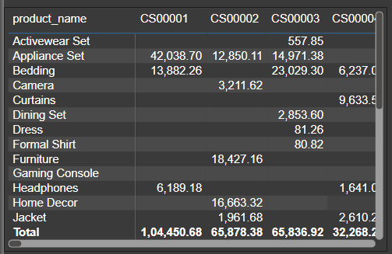
Analyzing Product Performance Across Customer Segments
The table provides a breakdown of sales for various products across different customer segments (CS00001, CS00002, CS00003, etc.).
Key Observations:
Product-Segment Fit: Products like Activewear Sets and Appliances show strong performance in specific segments (e.g., CS00001).
Segment-Specific Opportunities: Segments like CS00002 have a preference for Cameras, Curtains, and Home Decor.
Underperforming Products: Products like Dresses, Formal Shirts, and Gaming Consoles have limited appeal across segments.

Slide 12
Key Insights
Top-performing Countries: Brazil and Mexico dominate sales, followed by Colombia and Chile.
Age Distribution: A diverse customer base with a significant portion in the 22-27 age group.
Popular Product Categories: Activewear Sets, Appliances, and Bedding are top sellers.
Seasonal Trends: The line chart indicates potential seasonal fluctuations in sales.
Overall Performance: Strong revenue and order volume, indicating a healthy business.

Slide 13
Recommendations
Targeted Marketing: Implement targeted marketing campaigns for top-performing countries and age groups.
Product Focus: Prioritize high-demand products and optimize inventory levels.
Customer Loyalty: Implement loyalty programs to encourage repeat purchases.
Data-Driven Decisions: Continuously analyze data to identify trends and optimize strategies.
Supply Chain Optimization: Streamline operations to improve efficiency and reduce costs.
By leveraging these insights and recommendations, the e-commerce business can drive growth, enhance customer satisfaction, and achieve long-term success.

Slide 14
THANK YOU

